Slide 1

Smart Literature Review
Samah Hashim

Slide 2

Assistant professor
University of Business and Technology
Electrical Engineering
Solar energy, Renewable Energy, Electronics, Smart grids

Slide 3
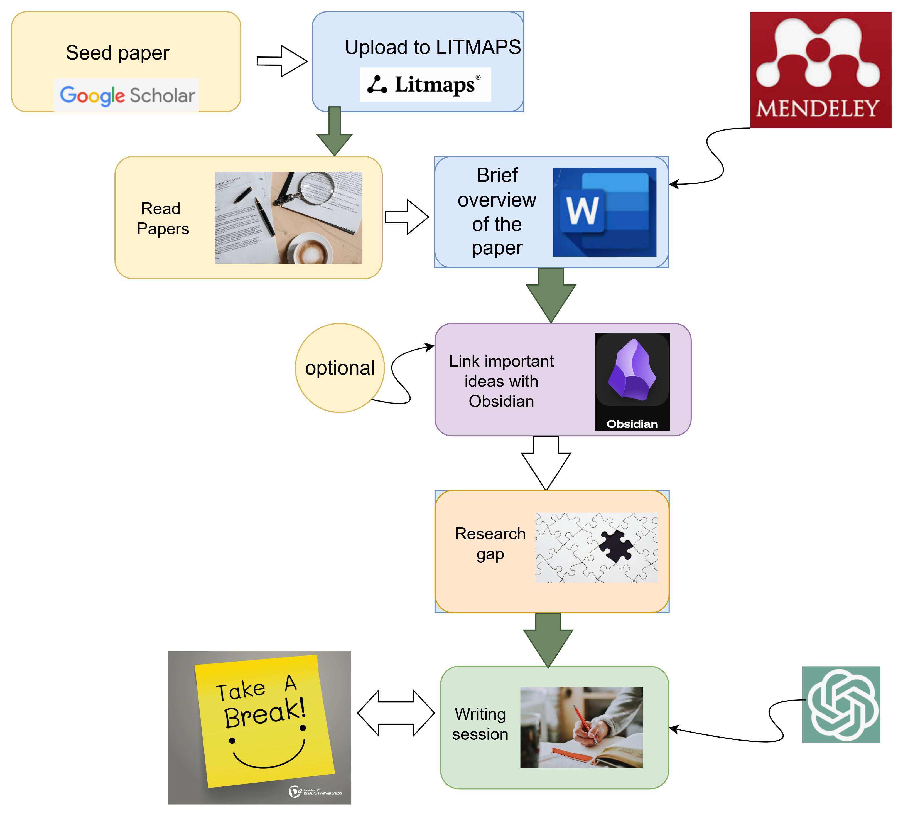












Slide 4

Why we need literature review?

Slide 5
Two elements of an effective research paper
Why this question
Research question
How to answer it
What did you find
Answer
introduction
Literature review
methodology
results
discussion

Slide 6
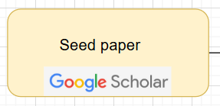
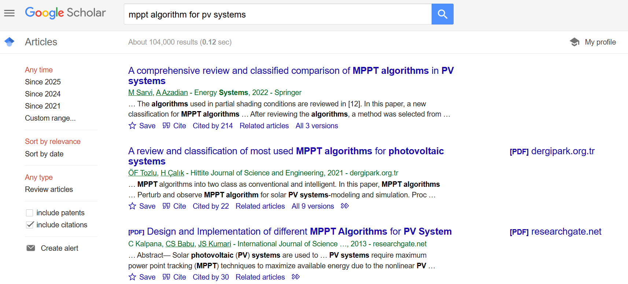
Link

Slide 7
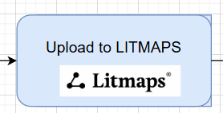
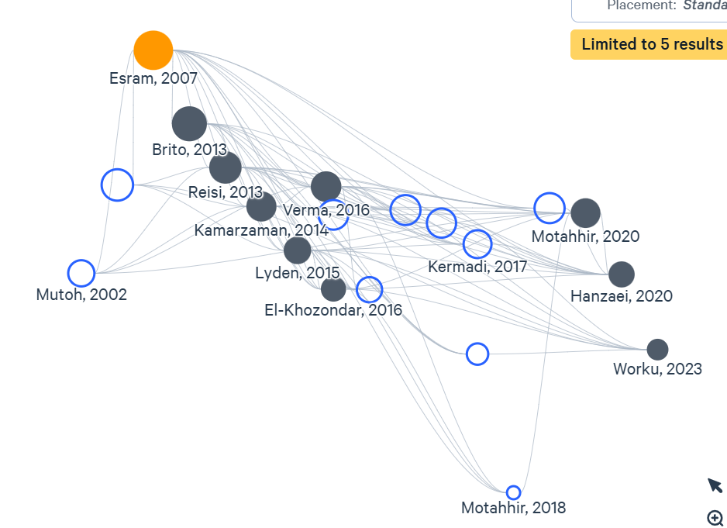
Link

Slide 8
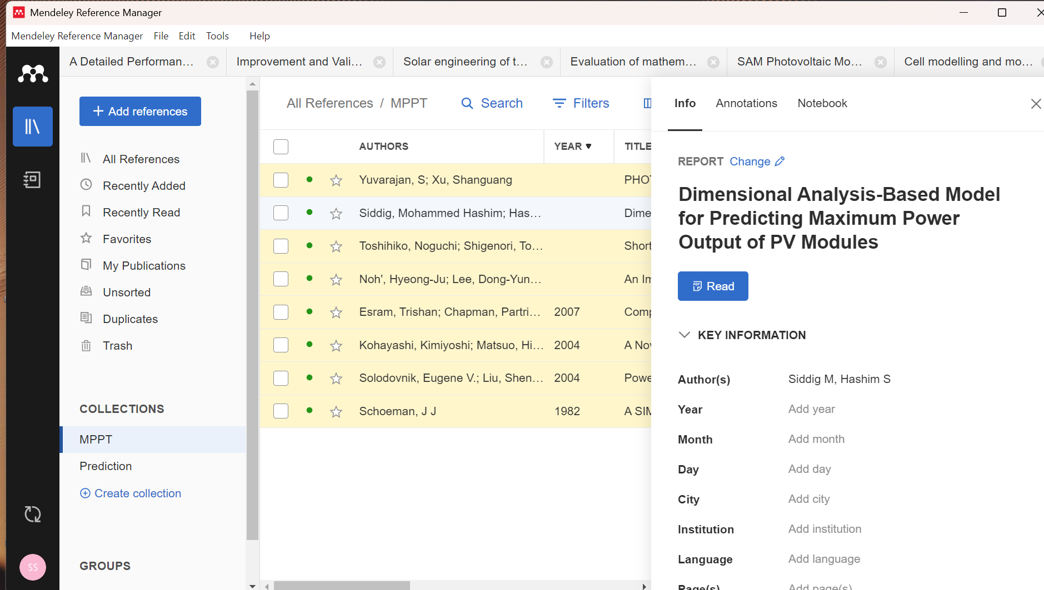

Slide 9

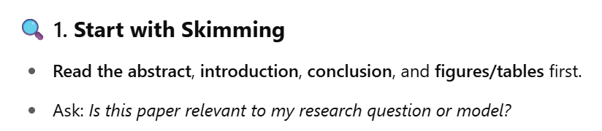
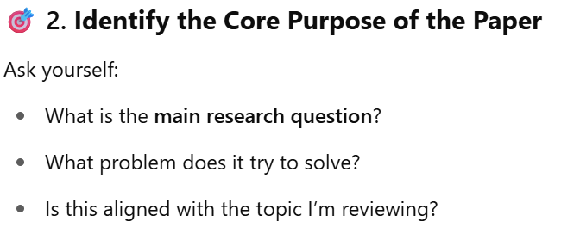

Slide 10
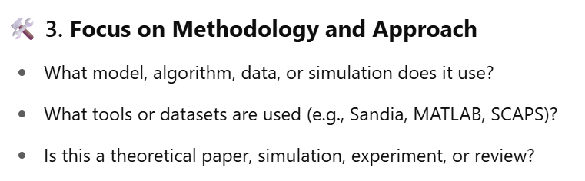
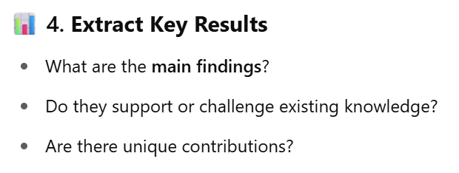

Slide 11
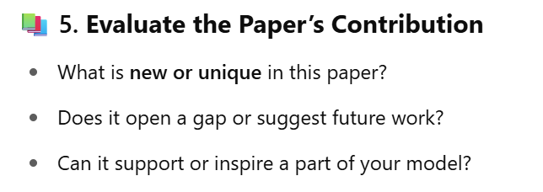

Slide 12

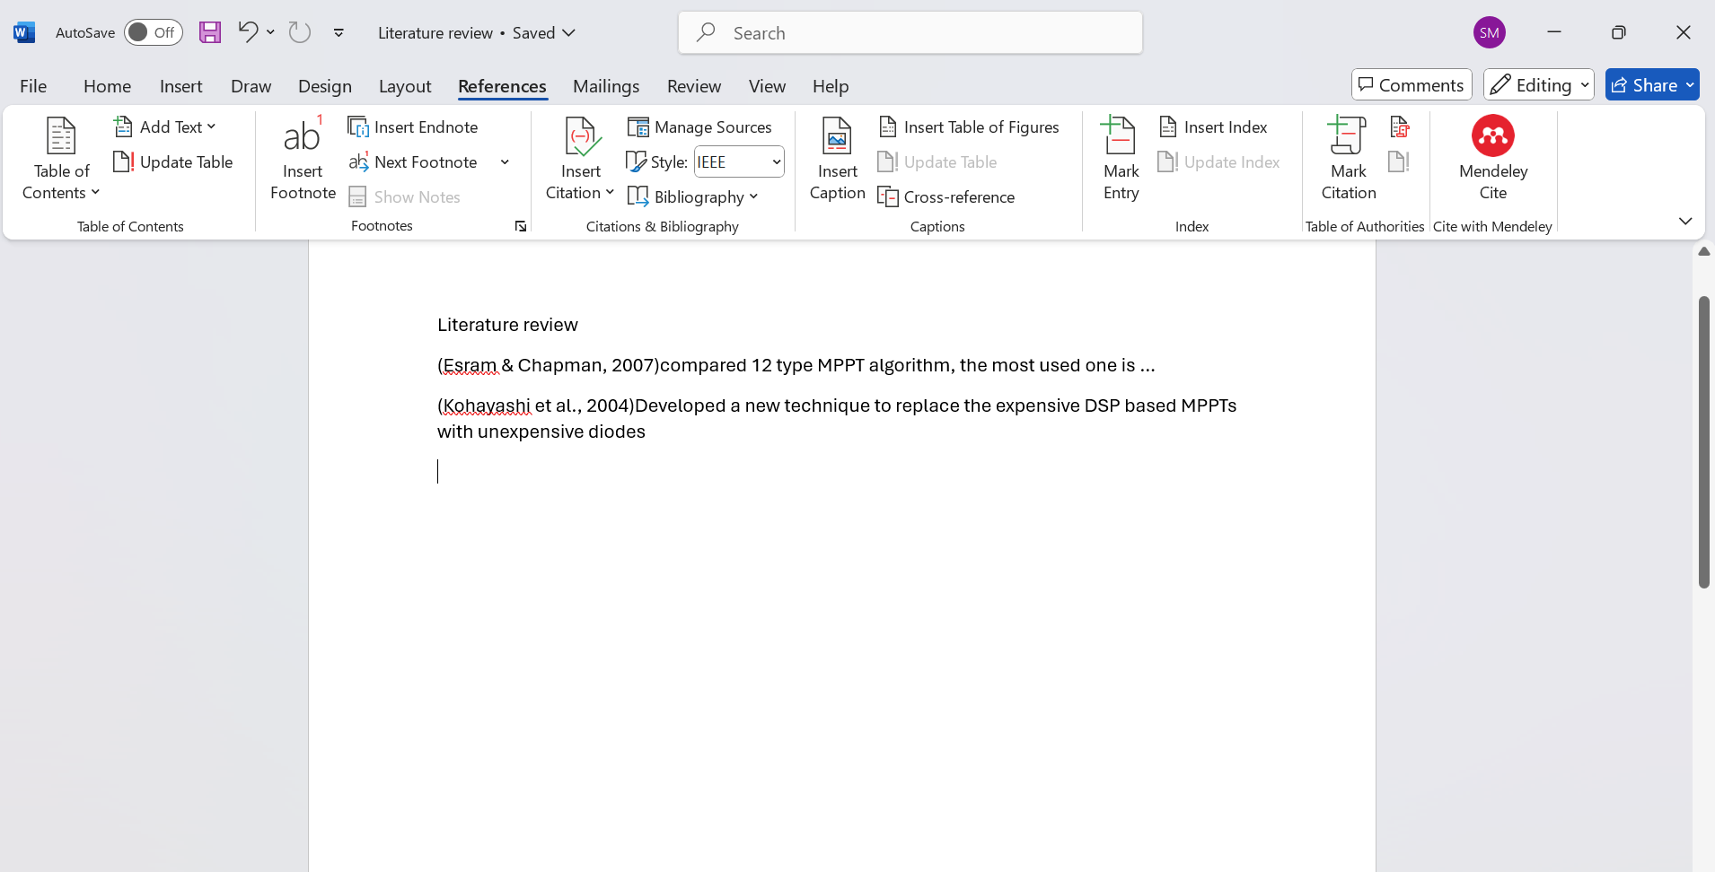
Link

Slide 13
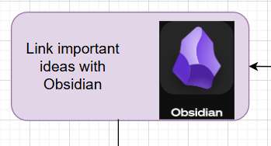
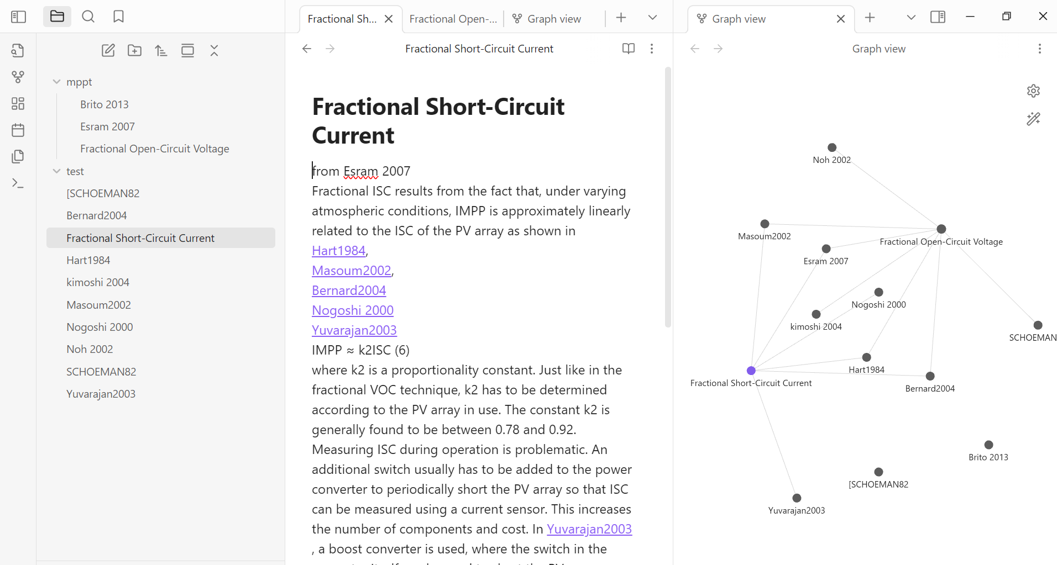
Link
Optional

Slide 14
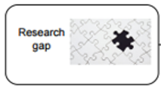
Type of Gap | Guiding Questions
🔬 Methodological gap | Is there a better or more modern method that hasn’t been applied yet?
🧪 Application gap | Has the method been tested in a different domain but not in yours?
🧭 Geographical/Data gap | Are most studies based on data from other regions/countries? What about local conditions?
📊 Performance gap | Are current methods underperforming? Can accuracy, speed, or robustness be improved?
🤖 Technological gap | Has new hardware/software emerged that hasn’t been leveraged?
📚 Theoretical gap | Is there a lack of explanation or model behind an observed effect?
🔄 Contradictions | Do some studies show conflicting results that need further analysis?

Slide 15
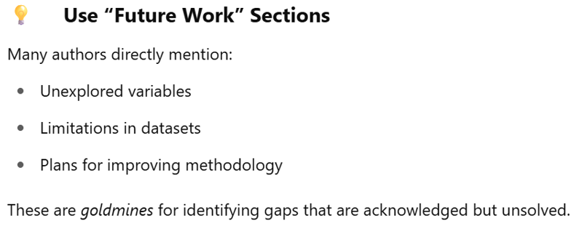

Slide 16

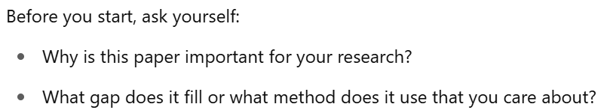
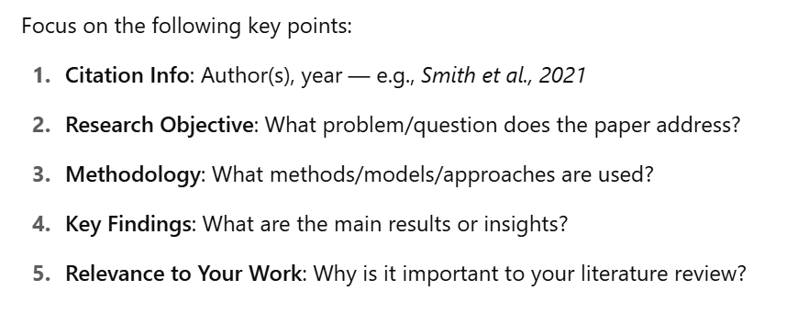

Slide 17
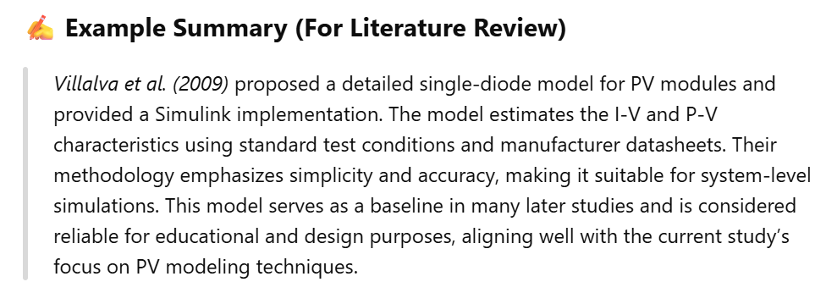

Slide 18
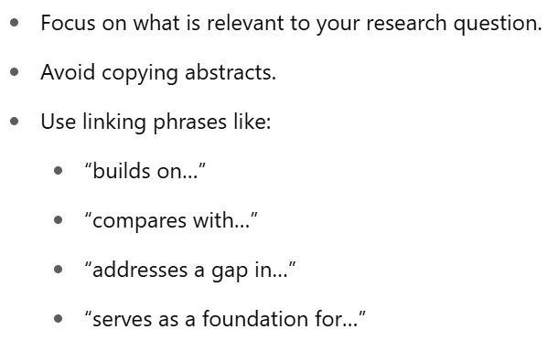
Link

Slide 19

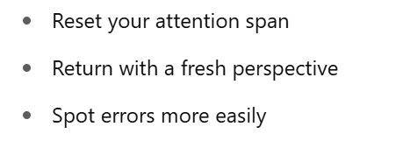
Write in 30 minuets basis

Slide 20
Using AI in writing without committing plagiarism

Slide 21
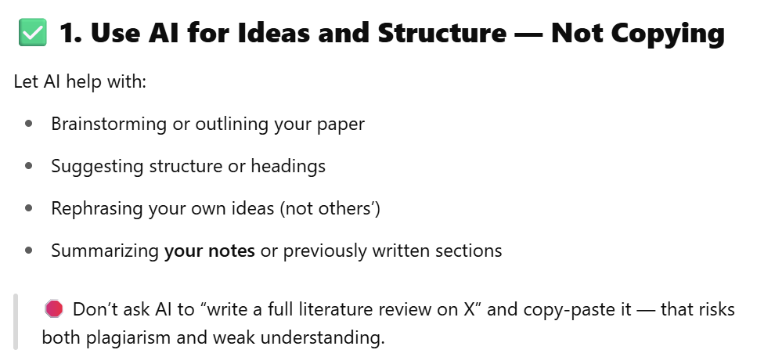
Link

Slide 22
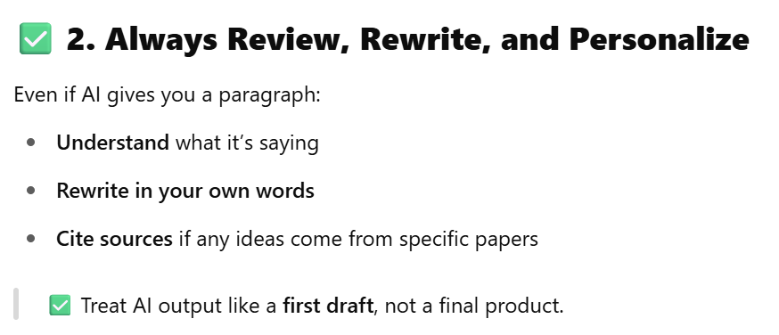

Slide 23
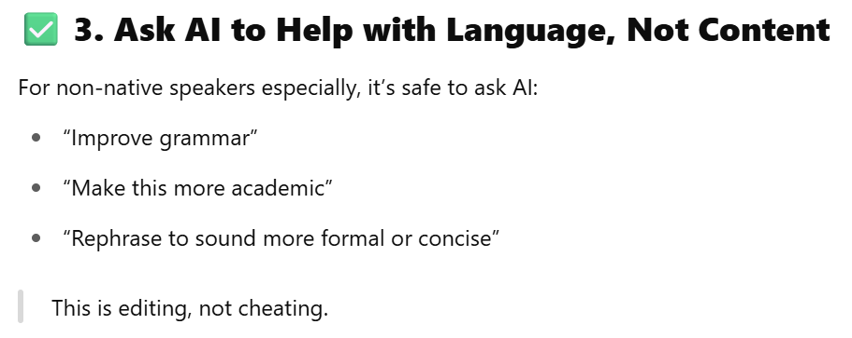

Slide 24
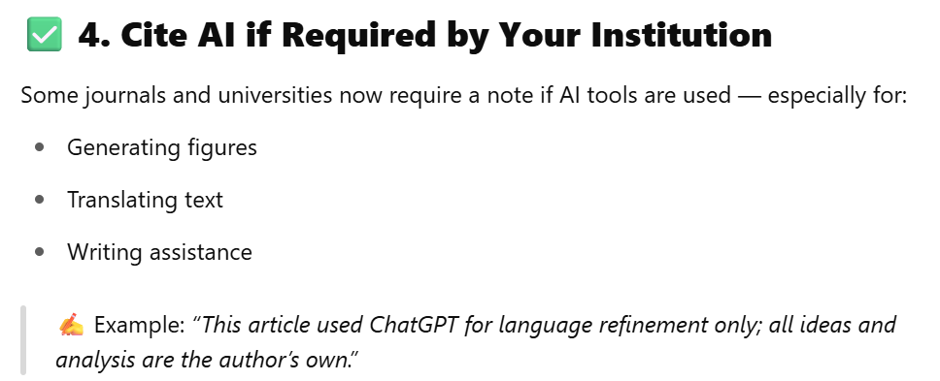

Slide 25
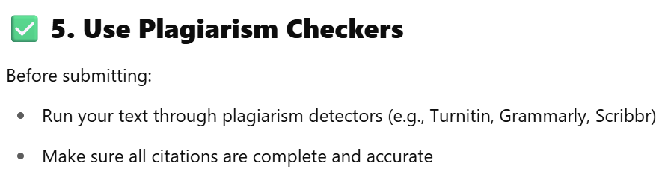

Slide 26


Slide 27

Samah Siddig
+966565592451
s.siddig@ubt.edu.sa
https://www.linkedin.com/in/samah-hashim-74b58436/

